Slide 1
A stakeholder is any person, group or organizational unit that will be influenced by (or will influence) the actions you take to accomplish your goals.
Stakeholders can be inside or outside your organization and may have positive or negative interests. For example, some stakeholders may know that they will receive benefits from an initiative or project. As such, they would be expected to have a positive interest in your success.
Other stakeholders may have concerns that your actions may have a negative effect on their interests. For example, your success may mean that a site from your company gets shutdown, which would be considered negative most employees in that site.

Slide 2
Steps
Prepare a list of each individual, group, unit or organization that has a stake in your project.
Identify their interests and expectations
Mark with a (+) or a (-) on whether each of those interests or expectations are positive or negative.
Rate the importance of each stakeholder to the successful completion of your project
Plan actions you must take to meet, clarify or realign the interests and expectations of each stakeholder with your project goals

Slide 3
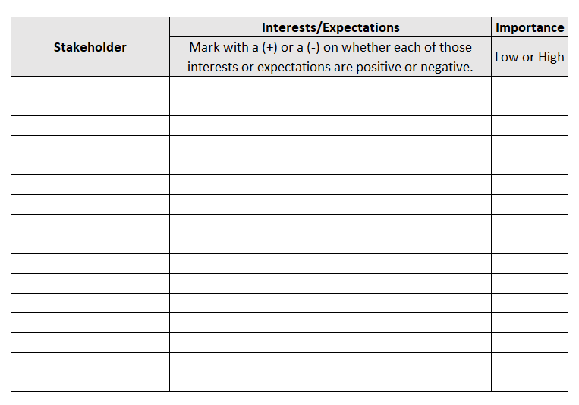

Slide 4
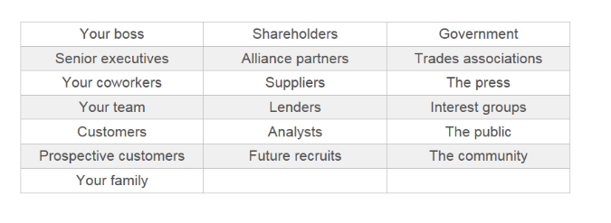
Non-comprehensive list of potential stakeholders for a project

Slide 5
